Slide 2
Experimental Details
Used samples: 1013A; 1021A; HCR 154; HCR 153
Plasma (20 microliter)
Concentration: unknown.
Size Distribution: Unknown.
Experimental duration: 60 min.
Antibody used: CD9, CD81, and CD63.

Slide 3
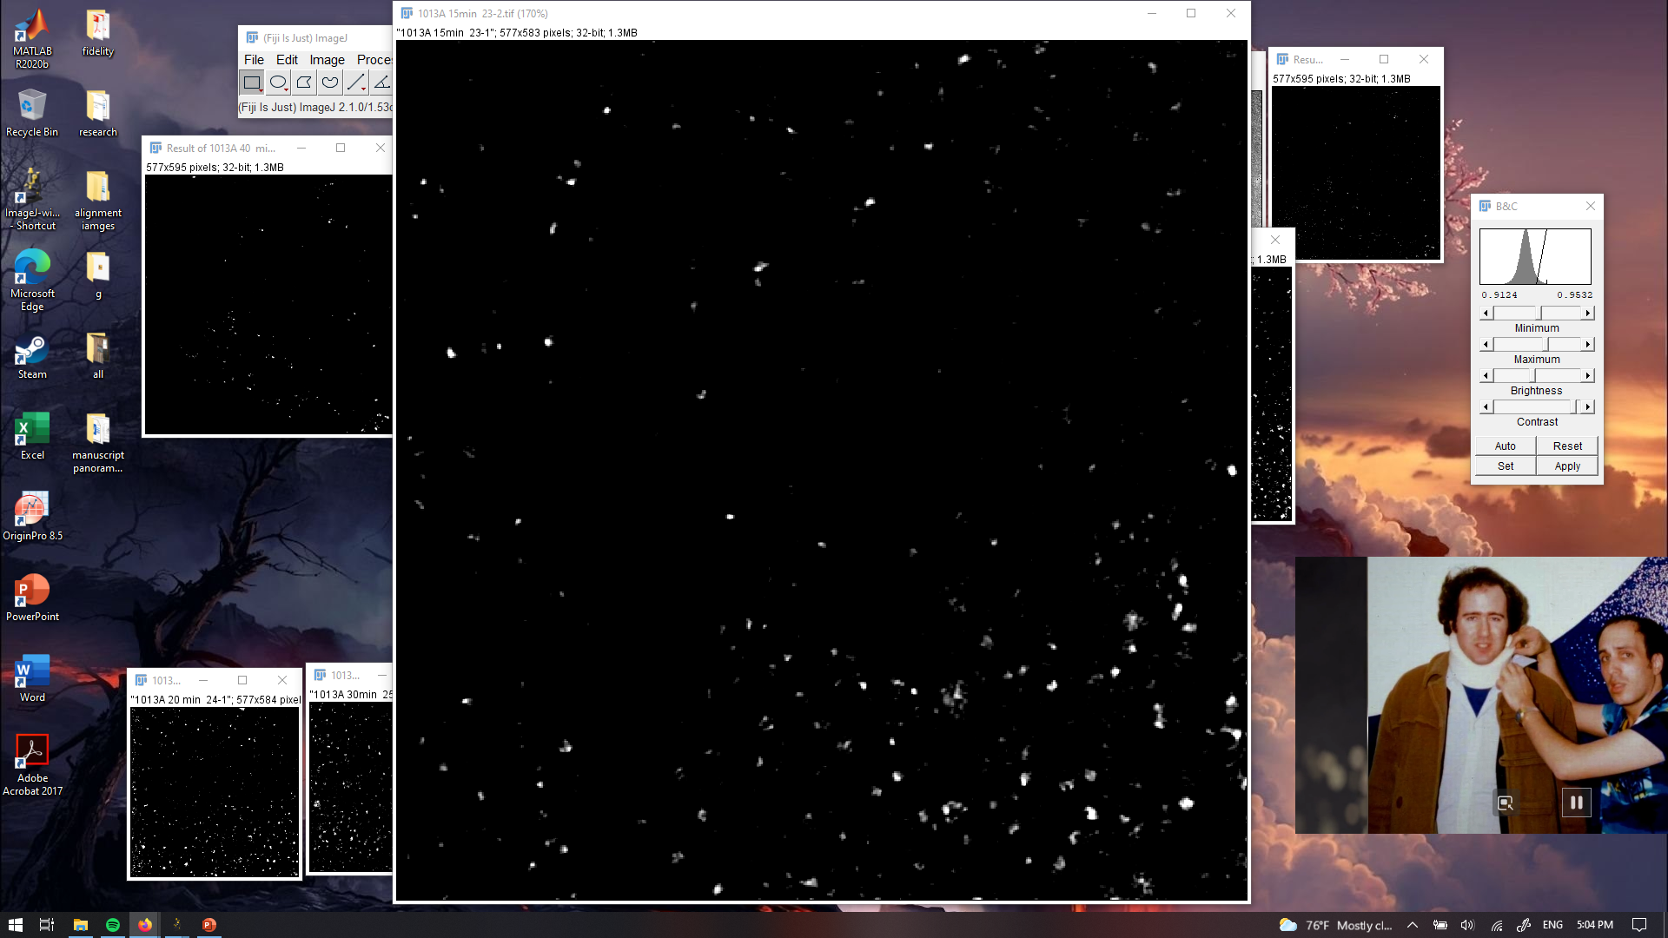
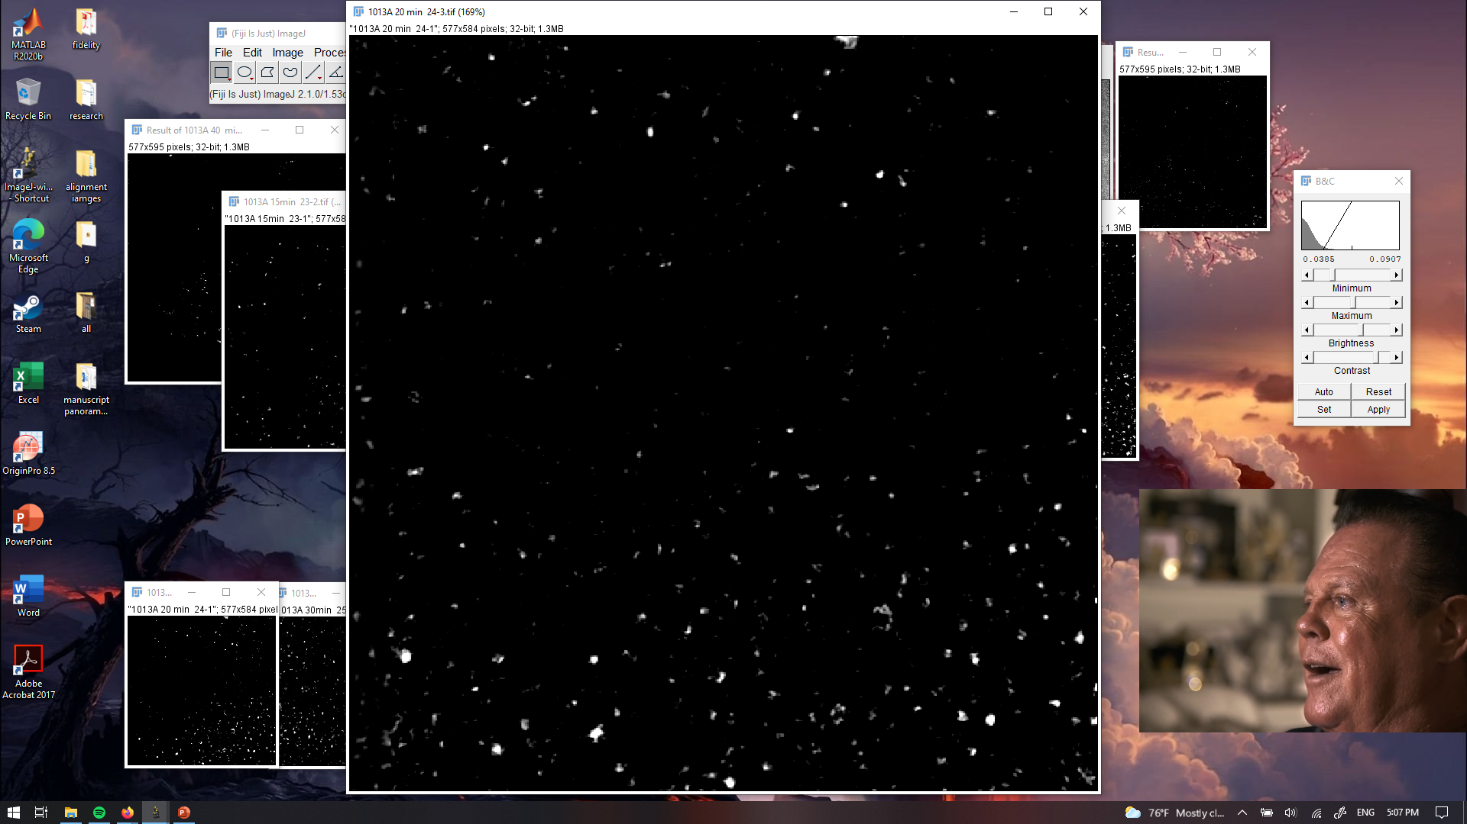
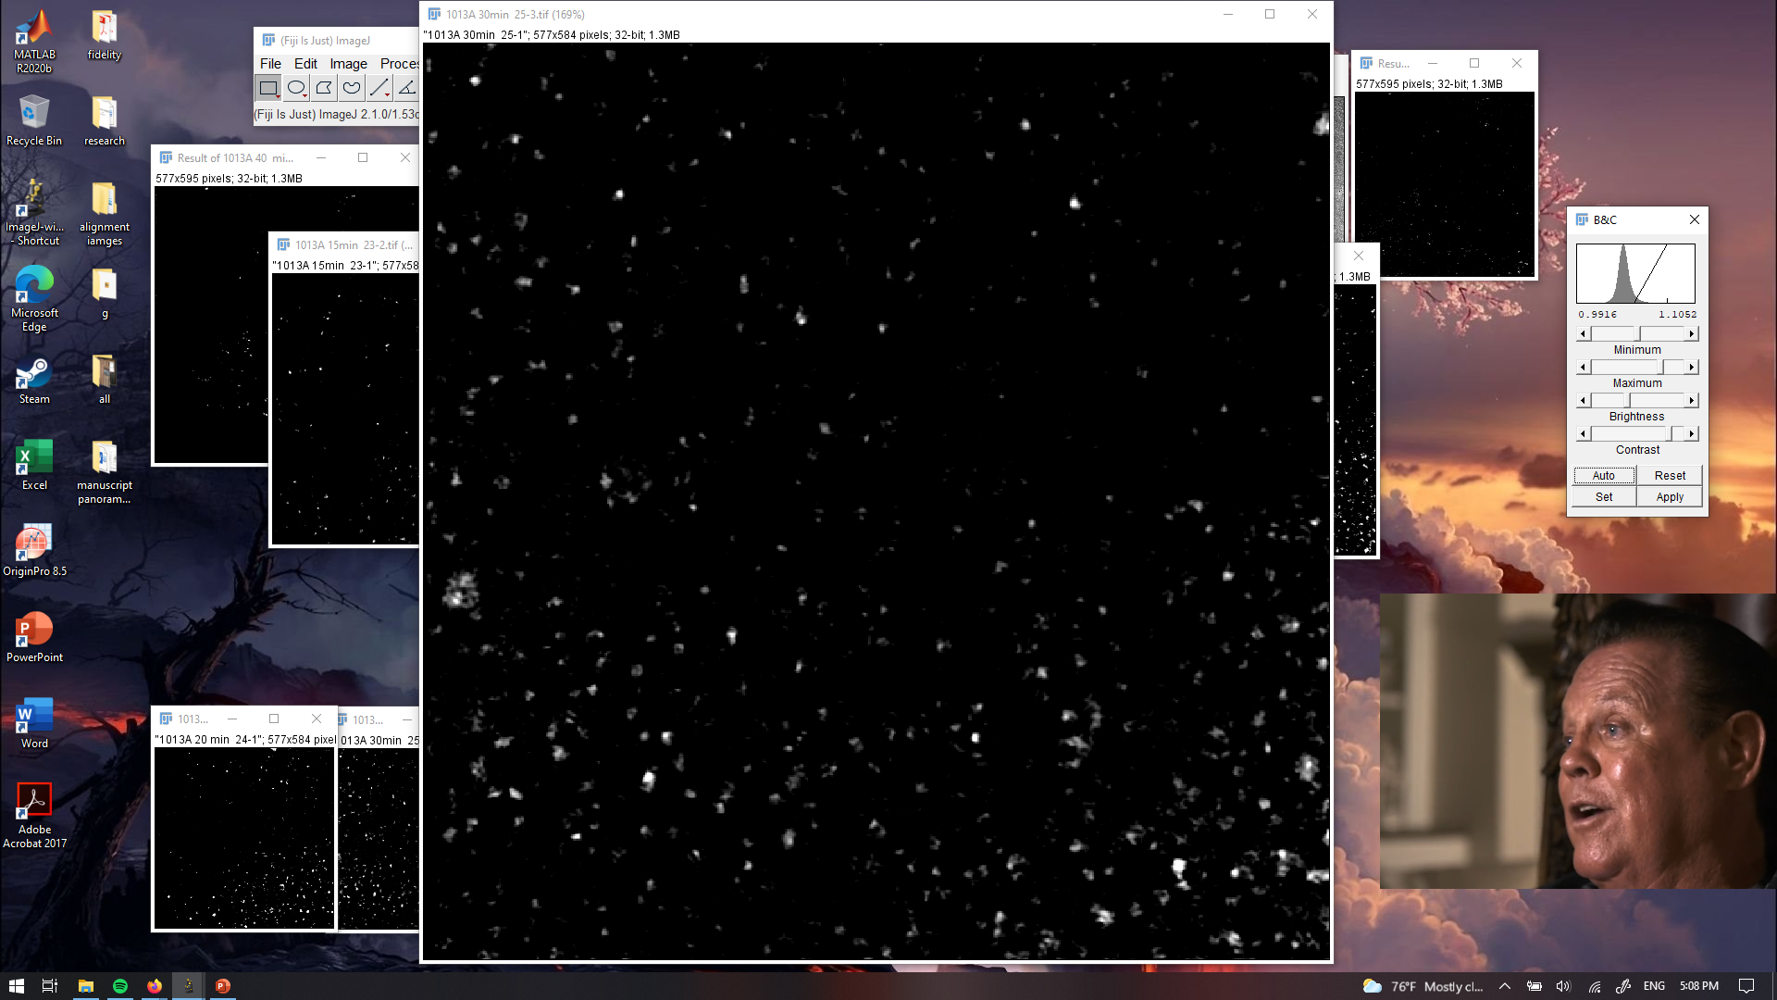
PANORAMA of plasma sample 1013A at different times
PANORAMA
Time: 15 min
Count: 789
PANORAMA
Time: 30 min
Count: 1116
PANORAMA
Time: 60 min
Count: 1759
Scale bar: 10 µm

Slide 4
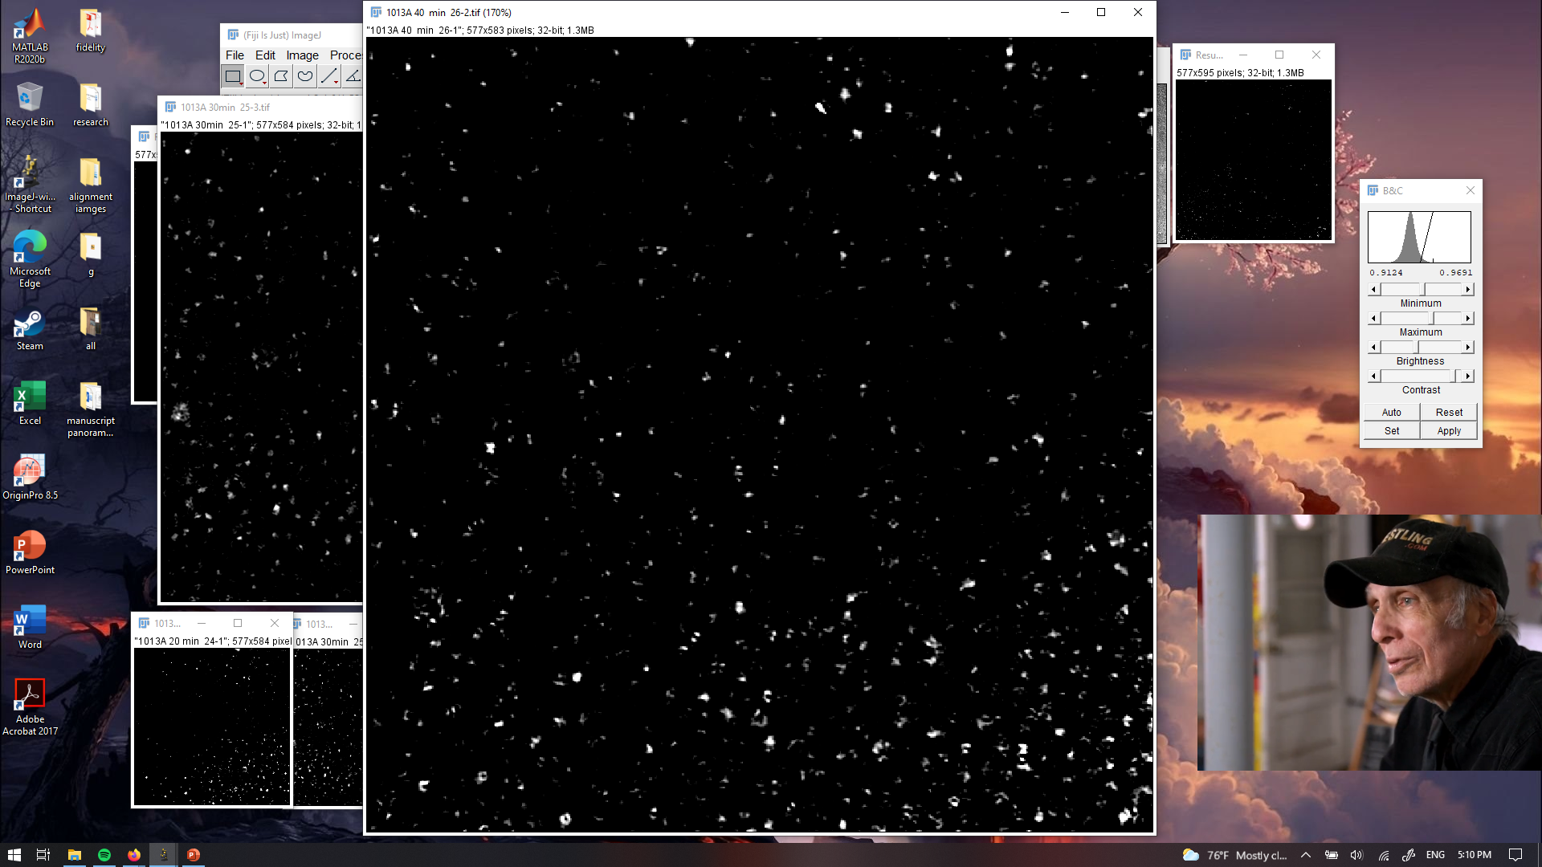
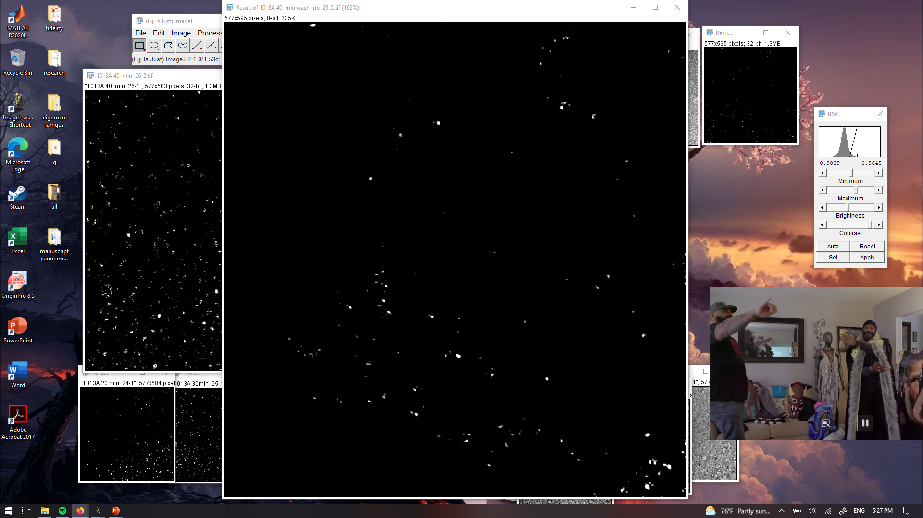
PANORAMA of plasma sample 1013A at different times
PANORAMA
Time: 60 min
Count: 2239
PANORAMA (1.11 ± 0.027)
Time: 60 min wash
Count: 174
8 % of detected particles captured after wash
Scale bar: 10 µm

Slide 5
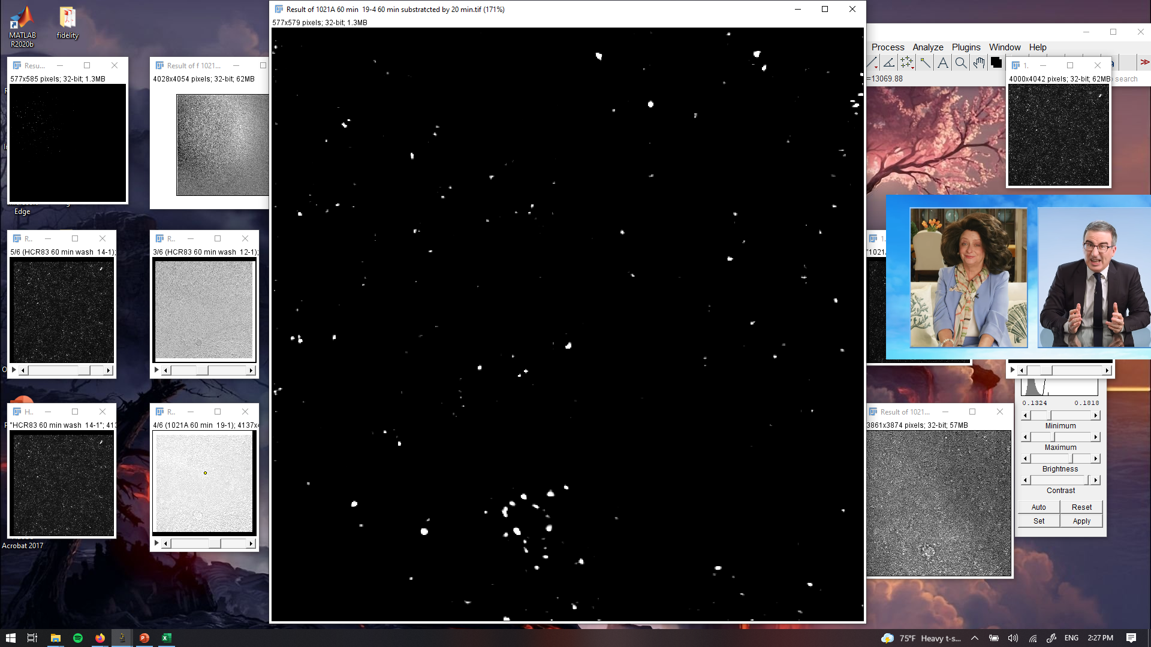
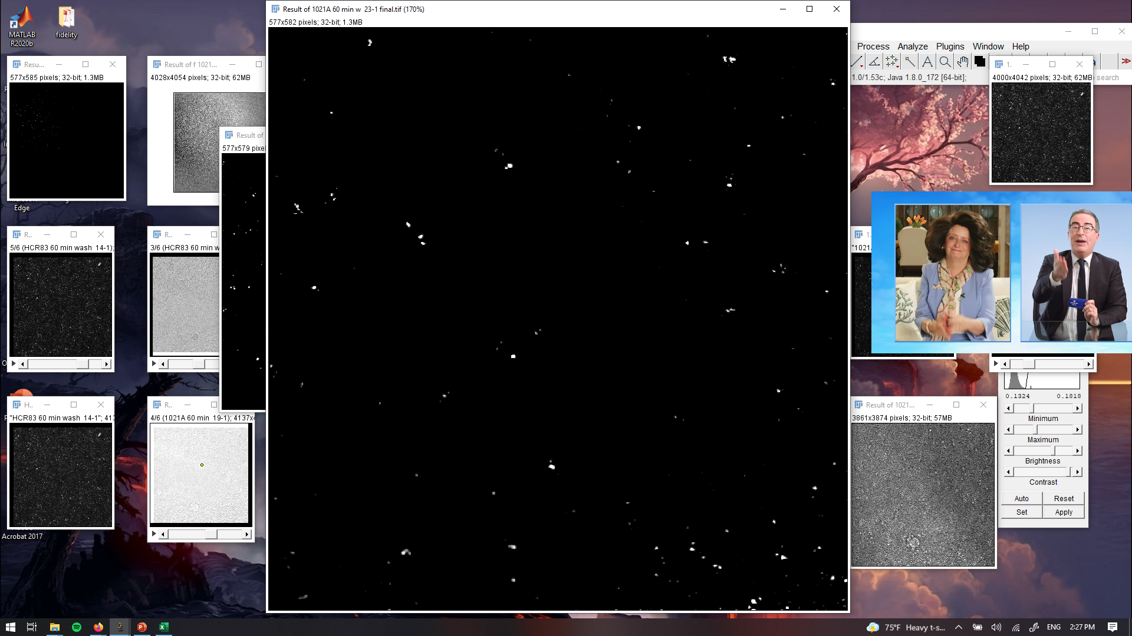
PANORAMA of plasma sample 1021A at different times
PANORAMA
Time: 60 min
Count: 251
PANORAMA (1.09 ± 0.032)
Time: 60 min wash
Count: 118
8 % of detected particles captured after wash
Scale bar: 10 µm

Slide 6
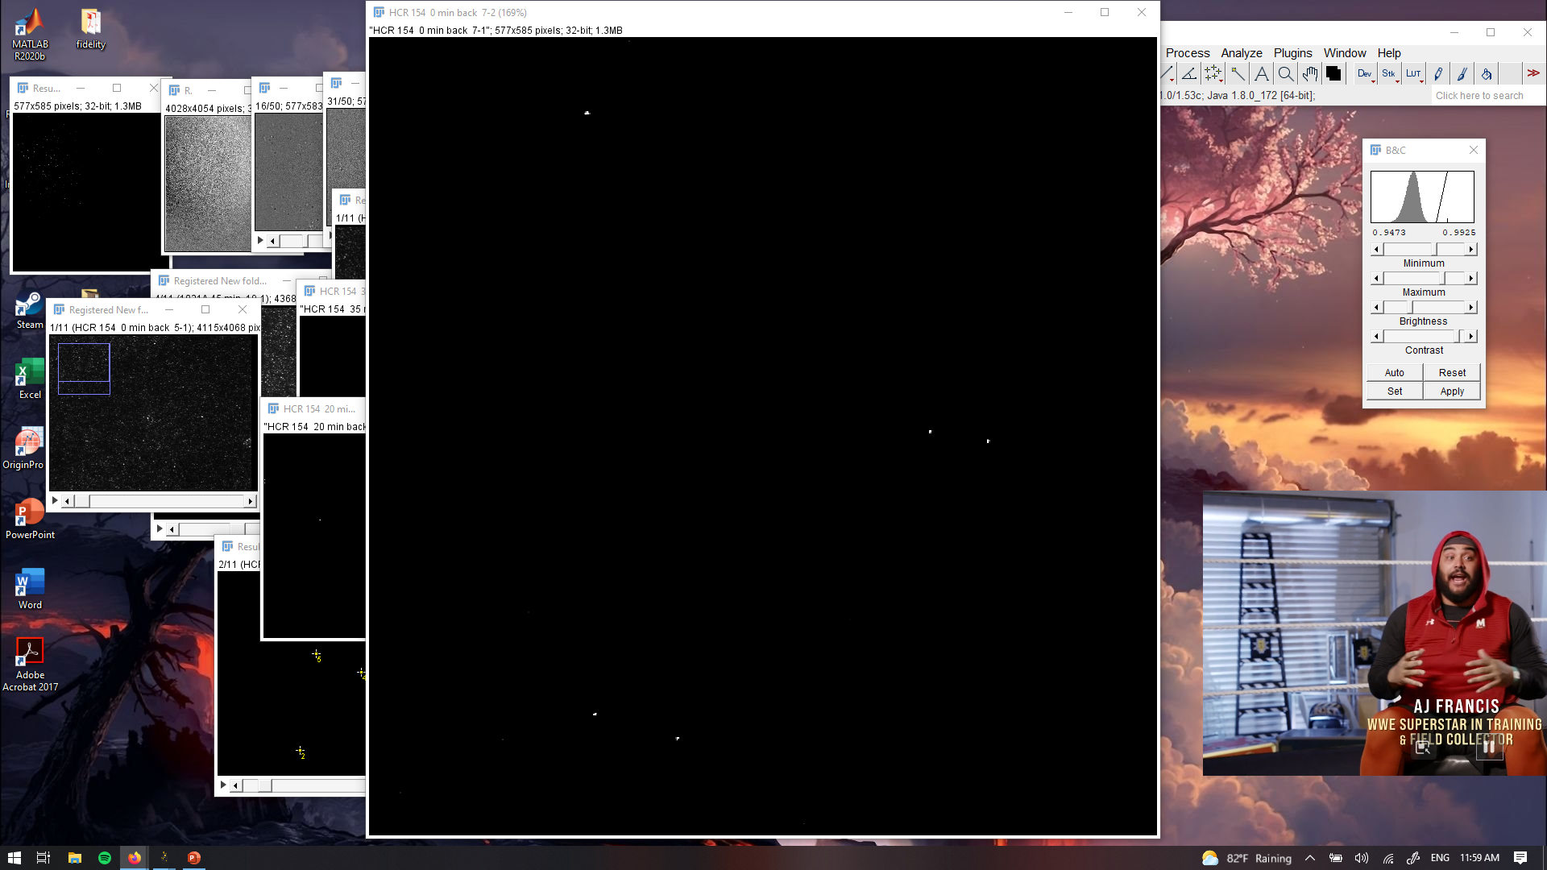
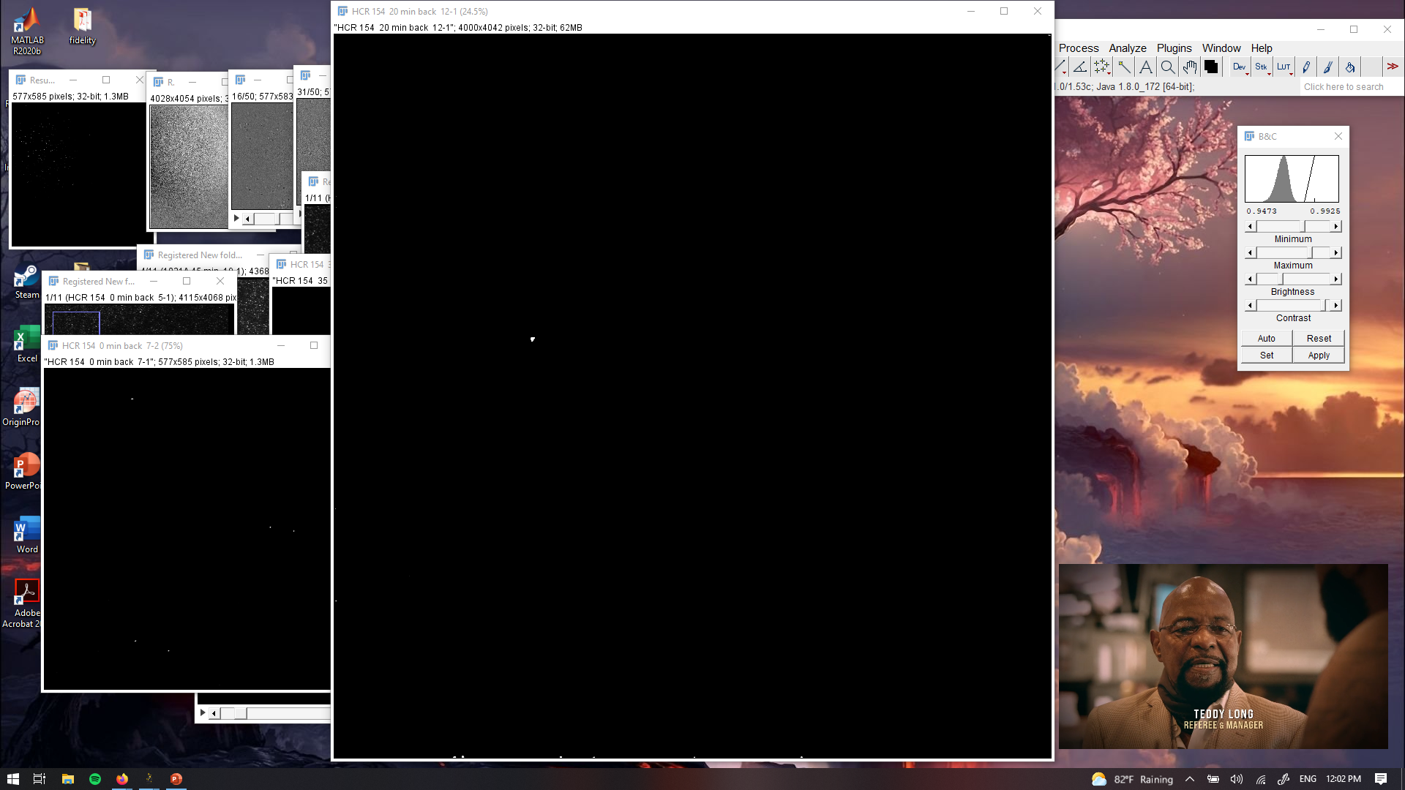
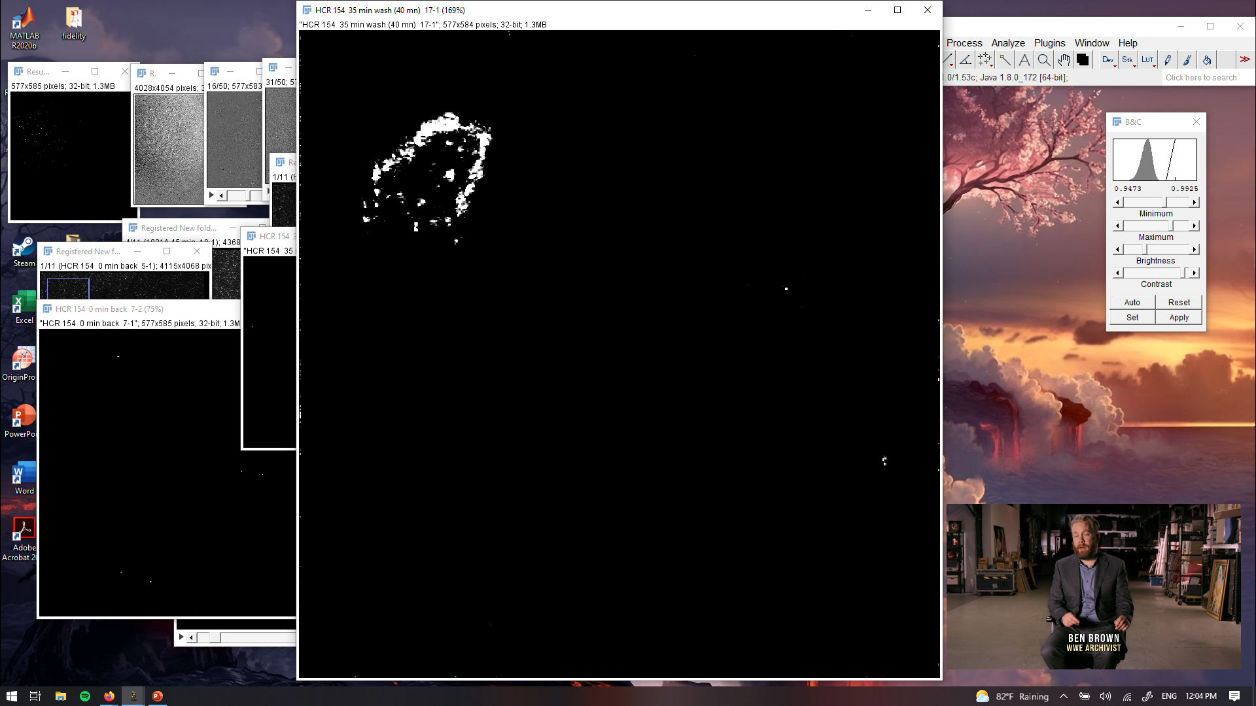
PANORAMA of plasma sample HCR 154 at different times
PANORAMA
Time: 20 min
Count: 5
PANORAMA
Time: 40 min
Count: 1
PANORAMA
Time: 60 min
Count: 3
Scale bar: 10 µm

Slide 7
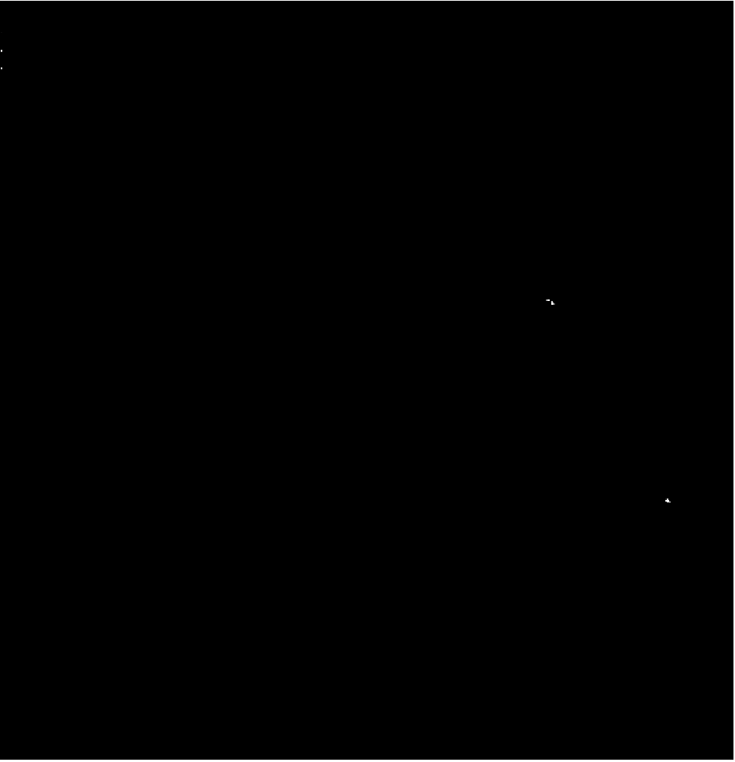
PANORAMA of plasma sample HCR 154 at different times
PANORAMA
Time: 60 min
Count: 3
PANORAMA (1.129 ± 0.009)
Time: 60 min wash
Count: 2
Scale bar: 10 µm

